Slide 1
RDBMS Fundamentals

Slide 2
Introduction to RDBMS
What is Relational Database?
A relational database is where information or data is stored in one or more tables combining rows and columns.
It organizes data into logical connections or relationships for the user to understand how various data structures relate to each other.
In a relational database model, two tables are related using a common attribute.

Slide 3
Introduction to RDBMS
What is RDBMS?
According to Oracle’s RDBMS definition, a relational database management system is software that allows users to store, manage, query, and retrieve data that is stored in a relational database.
Data in RDBMS is stored in tables with rows and columns. Modern database systems such as MySQL, SQL Server, Oracle, etc. are all based on RDBMS.
Most relational database management systems use SQL or Structured Query language to access a database.

Slide 4
Introduction to RDBMS
Evolution of RDBMS
Pre-Relational Era (1960s)
Before RDBMS, two major types of database models were common:
✔ Hierarchical Databases
Data stored in a tree-like structure (parent–child).
Used by IBM IMS.
Fast for fixed, predictable relationships.
Not suitable for flexible or complex queries.
✔ Network Databases
Data organized in a graph structure.
Used CODASYL model.
More flexible than hierarchical but still complex to manage.

Slide 5
Introduction to RDBMS
Evolution of RDBMS
Birth of the Relational Model (1970)
✔ Introduced by Dr. E.F. Codd (IBM)
Published the famous paper “A Relational Model of Data for Large Shared Data Banks.”
Proposed representing data using tables (relations).
Introduced concepts of:
Primary keys
Foreign keys
Normalization
Relational algebra
Impact
Simpler compared to network/hierarchical models.
Strong mathematical foundation.
Foundation of modern RDBMS.

Slide 6
Introduction to RDBMS
Evolution of RDBMS
Early RDBMS Implementations (1970s–1980s)
✔ System R (IBM)
First experimental RDBMS implementing SQL.
✔ Ingres (University of California, Berkeley)
Contributed to query optimization and relational theory.
✔ SQL Introduction
SQL (Structured Query Language) created.
Became standard language for querying relational databases.

Slide 7
Introduction to RDBMS
Evolution of RDBMS
Commercial RDBMS Rise (1980s–1990s)
Major RDBMS products entered the market:
✔ Oracle (1979)
First commercially available SQL-based RDBMS.
✔ IBM DB2 (1983)
Based on System R prototype.
✔ Microsoft SQL Server (1989)
✔ Sybase, Informix, Teradata
Each contributed enhancements such as:
Transaction support
Distributed database capabilities
Advanced query optimization

Slide 8
Introduction to RDBMS
Evolution of RDBMS
Standardization and Maturity (1990s–2000s)
✔ SQL Standards (ANSI/ISO)
SQL-89
SQL-92
SQL-99
SQL:2003 and beyond
Key Enhancements
Triggers
Stored procedures
Views
Transactions (ACID)
JDBC/ODBC connectivity
Adoption Across Industries
Used in banking, telecom, ERP systems, e-commerce, government.

Slide 9
Introduction to RDBMS
Evolution of RDBMS
Modern Era of RDBMS (2000s–Present)
✔ Open-Source RDBMS
MySQL
PostgreSQL
MariaDB
SQLite
These brought:
Lower cost
High performance
Cloud readiness
✔ Distributed SQL Databases
Designed for scalability across clusters:
Google Spanner
CockroachDB
YugabyteDB
✔ Cloud-Native RDBMS
Managed services:
Amazon RDS / Aurora
Azure SQL Database
Google Cloud SQL

Slide 10
Introduction to RDBMS
Evolution of RDBMS
Integration with Big Data & Microservices (2015–Present)
Trends
Hybrid databases supporting SQL + NoSQL features.
JSON support inside RDBMS (PostgreSQL, MySQL).
Horizontal auto-scaling.
Integration with analytical engines.
Modern Use Cases
Microservices architectures
Real-time analytics
Transaction-heavy systems
SAAS platforms

Slide 11
Introduction to RDBMS
Features of RDBMS
It offers functions related to creating, reading, updating, and deleting operations to be performed on data.
It provides data dictionaries and metadata collections which help in data handling.
Another common feature is data storage management. The data objects range from binary large objects to strings to stored procedures.
SQL is the most commonly used language to access RDBMS. With certain extensions, it can be used with common programming languages such as Common Business-oriented Language, Java, etc.

Slide 12
Introduction to RDBMS
Features of RDBMS
Multiple users can concurrently access a database without the data integrity being compromised.
It provides security management since it is used mostly in enterprises.
It supports the work of database administrators who must manage and monitor database activity. With the help of utilities, data loading, and database backup are automated.
It manages log files that track system performance based on selected operational parameters.
It provides a graphical interface that helps database administrators visualize database activity.

Slide 13
Introduction to RDBMS
Importance of RDBMS in Modern Computing
Relational Database Management Systems (RDBMS) are a foundational part of modern software systems.
They power applications across finance, e-commerce, healthcare, government, and more.
Their importance comes from their ability to manage structured data reliably, securely, and efficiently.

Slide 14
Introduction to RDBMS
Importance of RDBMS in Modern Computing
Reliable Data Storage and Management
RDBMS provide a stable and consistent way to store data using tables, relationships, and constraints.
They ensure:
Data accuracy
Data consistency
Data reliability
This is essential for systems that cannot tolerate incorrect or inconsistent data (e.g., banking, billing).

Slide 15
Introduction to RDBMS
Importance of RDBMS in Modern Computing
ACID Transaction Support
RDBMS support ACID properties, which guarantee safe and predictable transactions:
Atomicity
Consistency
Isolation
Durability
This makes RDBMS ideal for:
Online banking
E-commerce checkouts
Reservation systems
Inventory systems

Slide 16
Introduction to RDBMS
Importance of RDBMS in Modern Computing
Powerful Querying with SQL
SQL allows users to:
Retrieve data
Filter and sort
Join tables
Perform aggregations
Manage access and schemas
Its expressive, standardized syntax makes it easy for developers and analysts to extract insights from data.

Slide 17
Introduction to RDBMS
Importance of RDBMS in Modern Computing
Security and Access Control
RDBMS provide strong security mechanisms:
User roles & permissions
Encryption
Auditing
Access control policies
This protects sensitive data such as:
Customer information
Financial data
Healthcare records

Slide 18
Introduction to RDBMS
Importance of RDBMS in Modern Computing
Multi-User Support
RDBMS handle many users performing simultaneous operations without conflicts.
This is critical for:
Web applications
ERP systems
CRM systems
SaaS platforms

Slide 19
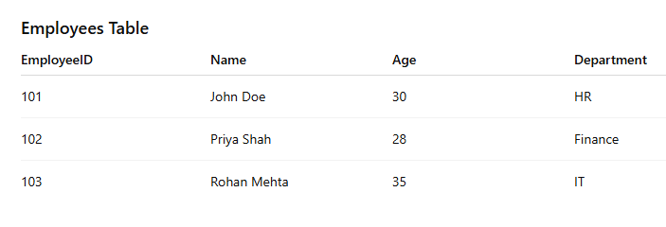
Introduction to RDBMS
Concepts of RDBMS
Some of the essential RDBMS concepts are as follows.
Table- In an RDBMS, data is stored in tables. A table is a collection of related data entries and consists of several columns and rows.

Slide 20
Introduction to RDBMS
Concepts of RDBMS
Table
Key Characteristics of a Table
✔ Has a unique name
Each table in a database must have a unique name.
✔ Stores related data
All rows in a table represent the same type of entity.
✔ Defined structure
Columns have:
Names
Data types
Constraints (NOT NULL, UNIQUE, etc.)
✔ Supports constraints
Tables enforce business rules through:
Primary Key
Foreign Key
Unique
Check
Default

Slide 21
Introduction to RDBMS
Concepts of RDBMS
Importance of Tables in RDBMS
Tables allow:
Organized data storage
Easy retrieval and searching
Enforcing relationships
Ensuring data integrity
Supporting business logic

Slide 22
Introduction to RDBMS
Concepts of RDBMS
Field- A field is a column where one enters specific information about the records in a table.
These are the common data types you use while defining table fields:
Numeric
INT – Integer values
BIGINT – Large integers
SMALLINT – Small integers
FLOAT – Floating point numbers
DECIMAL(p, q) – Exact numeric values (money, prices)

Slide 23
Introduction to RDBMS
Concepts of RDBMS
Fields
String / Text
VARCHAR(n) – Variable-length text
CHAR(n) – Fixed-length text
TEXT or LONGTEXT – Long text content
Date & Time
DATE – Only date
TIME – Only time
TIMESTAMP – Date + time
DATETIME – Date + time (varies by RDBMS)
Boolean
BOOLEAN or TINYINT(1) – true/false
Binary
BLOB – Binary large objects
VARBINARY – Binary data
UUID
A unique identifier (UUID, GUID)

Slide 24

Introduction to RDBMS
Concepts of RDBMS
Record or Row- A record or a row in a table consists of an individual entry. It is a single row of data.
Key Properties of a Record
A record contains values for all the fields in the table.
Every record is unique, usually because of a primary key.
Multiple records together form a table.

Slide 25
Introduction to RDBMS
Concepts of RDBMS
A column in an RDBMS (Relational Database Management System) is:
Definition
A column is a vertical structure in a table that represents a single field or attribute of the data.
Each column has:
A name (e.g., employee_id, first_name)
A data type (e.g., INT, VARCHAR, DATE)
Optional constraints (e.g., PRIMARY KEY, NOT NULL, UNIQUE)

Slide 26
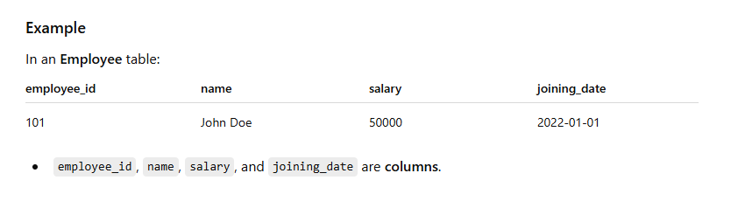
Introduction to RDBMS
Concepts of RDBMS
Key Characteristics of a Column
Represents one attribute of an entity.
All values in a column have the same data type.
Columns form the schema of a table.
Columns support constraints to control data accuracy.

Slide 27
Introduction to RDBMS
Concepts of RDBMS
A NULL value in an RDBMS represents missing, unknown, or not applicable data.
Definition
NULL means no value. It is not:
Not zero (0)
Not an empty string ('')
Not a space (' ')
It literally means: the value does not exist or is not known.

Slide 28
Introduction to RDBMS
Concepts of RDBMS
Why NULL is used?
Situations where NULL is appropriate:
A person’s middle name is unknown → NULL
An employee resignation_date is not yet applicable → NULL
A product discount not provided → NULL

Slide 29
Introduction to RDBMS
Concepts of RDBMS
NOT NULL Constraint: Ensures that a column cannot have NULL value.
DEFAULT Constraint: Provides a default value for a column when none is specified.
UNIQUE Constraint: Ensures that all values in a column are different.
PRIMARY Key: Uniquely identified each rows/records in a database table.
FOREIGN Key: Uniquely identified a rows/records in any another database table.
CHECK Constraint: The CHECK constraint ensures that all values in a column satisfy certain conditions.

Slide 30
Introduction to RDBMS
Concepts of RDBMS
SQL constraints are rules applied to table columns to ensure data accuracy, consistency, and integrity in an RDBMS.
Types of SQL Constraints (Most Common)
1️⃣ NOT NULL
Ensures the column cannot store NULL values.
CREATE TABLE employees (
emp_id INT NOT NULL,
name VARCHAR(100) NOT NULL
);

Slide 31
Introduction to RDBMS
Concepts of RDBMS
SQL constraints
UNIQUE
Ensures all values are different (no duplicates).
email VARCHAR(150) UNIQUE
Multiple NULL values are allowed unless combined with other constraints.

Slide 32
Introduction to RDBMS
Concepts of RDBMS
SQL constraints
PRIMARY KEY
Uniquely identifies each row
Combines NOT NULL + UNIQUE
Only one primary key per table
Can be single or composite (multiple columns)
emp_id INT PRIMARY KEY

Slide 33
Introduction to RDBMS
Concepts of RDBMS
SQL constraints
FOREIGN KEY
Enforces referential integrity by linking to a primary key in another table.
FOREIGN KEY (dept_id) REFERENCES departments(dept_id)

Slide 34
Introduction to RDBMS
Concepts of RDBMS
SQL constraints
CHECK
Ensures column values meet a specified condition.
salary INT CHECK (salary > 0)

Slide 35
Introduction to RDBMS
Concepts of RDBMS
SQL constraints
DEFAULT
Provides a default value when no value is supplied.
status VARCHAR(20) DEFAULT 'Active'

Slide 36
Introduction to RDBMS
Concepts of RDBMS
SQL constraints
INDEX (Not a strict constraint, but helps)
Speeds up searching and sorting.
CREATE INDEX idx_name ON employees(name);

Slide 37
Introduction to RDBMS
Concepts of RDBMS
SQL constraints
Example Table with All Major Constraints
CREATE TABLE employees (
emp_id INT PRIMARY KEY,
name VARCHAR(100) NOT NULL,
email VARCHAR(150) UNIQUE,
salary DECIMAL(10,2) CHECK (salary > 0),
dept_id INT,
status VARCHAR(20) DEFAULT 'Active',
FOREIGN KEY (dept_id) REFERENCES departments(dept_id)
);

Slide 38
Introduction to RDBMS
Concepts of RDBMS
Data Integrity
Data Integrity in an RDBMS refers to the accuracy, consistency, and reliability of data stored in a database.
It ensures that data remains correct, complete, and trustworthy over its lifecycle.

Slide 39
Introduction to RDBMS
Concepts of RDBMS
Types of Data Integrity
Entity Integrity
Ensures each row (record) is uniquely identifiable.
Enforced using Primary Keys.
Example: Every employee in the employees table must have a unique emp_id.
emp_id INT PRIMARY KEY

Slide 40
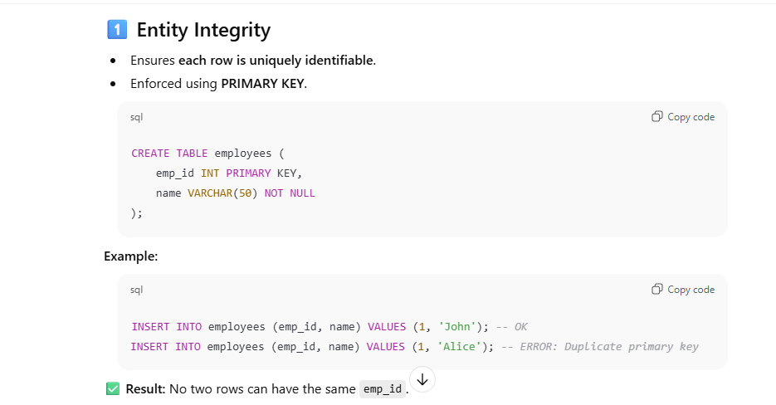
Introduction to RDBMS
Concepts of RDBMS

Slide 41
Introduction to RDBMS
Concepts of RDBMS
Types of Data Integrity
Referential Integrity
Ensures relationships between tables remain consistent.
Enforced using Foreign Keys.
Example: employees.dept_id must exist in departments.dept_id.
FOREIGN KEY (dept_id) REFERENCES departments(dept_id)

Slide 42
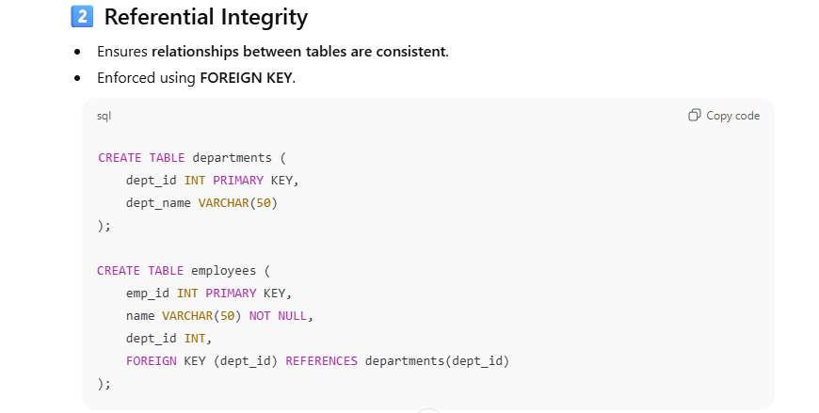
Introduction to RDBMS
Concepts of RDBMS
Types of Data Integrity

Slide 43
Introduction to RDBMS
Concepts of RDBMS
Types of Data Integrity
Domain Integrity
Ensures column values are valid and within allowed range or type.
Enforced using Data Types, CHECK constraints, and DEFAULT values.
Example: Salary cannot be negative.
salary DECIMAL(10,2) CHECK (salary > 0)

Slide 44
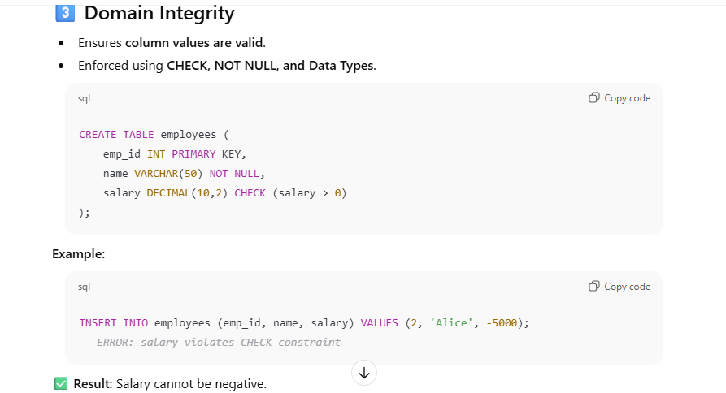
Introduction to RDBMS
Concepts of RDBMS
Types of Data Integrity

Slide 45
Introduction to RDBMS
Concepts of RDBMS
Data Integrity
User-Defined Integrity
Rules defined by business logic that don’t fit standard constraints.
Example: A student cannot register for more than 5 courses in a semester.
CHECK (course_count <= 5)

Slide 46
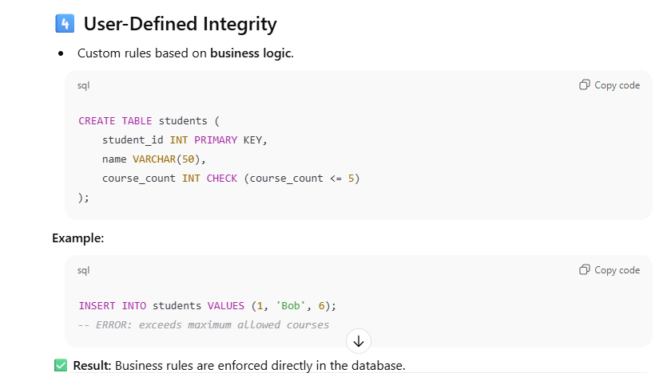
Introduction to RDBMS
Concepts of RDBMS
Data Integrity

Slide 47
Introduction to RDBMS
Concepts of RDBMS
Data Integrity
Benefits of Data Integrity
Accuracy – Data is correct and reliable.
Consistency – Related data across tables matches.
Prevents errors – Reduces invalid or inconsistent data entries.
Supports decision-making – High-quality data leads to better analysis.

Slide 48
Introduction to RDBMS
Normalization
Normalization is the process of organizing data in a database to:
Reduce data redundancy (duplicate data)
Avoid data anomalies (insert, update, delete problems)
Improve data integrity & consistency
Make tables easier to maintain and scale
Normalization mainly applies to relational databases (RDBMS) like MySQL, Oracle, SQL Server.

Slide 49
Introduction to RDBMS
Normalization
Problems without normalization:
Same data stored multiple times
Updating data in one place but not another
Deleting data accidentally removes useful info

Slide 50
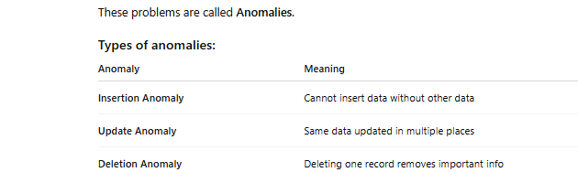
Introduction to RDBMS
Normalization

Slide 51
Introduction to RDBMS
Database Normalization
Levels of normalization based on the amount of redundancy in the database.
• Various levels of normalization are:
• First Normal Form (1NF)
• Second Normal Form (2NF)
• Third Normal Form (3NF)
• Boyce-Codd Normal Form (BCNF)
• Fourth Normal Form (4NF)
• Fifth Normal Form (5NF)

Slide 52
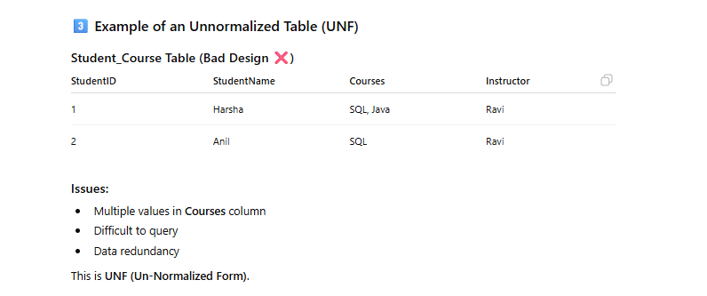
Introduction to RDBMS
Normalization

Slide 53
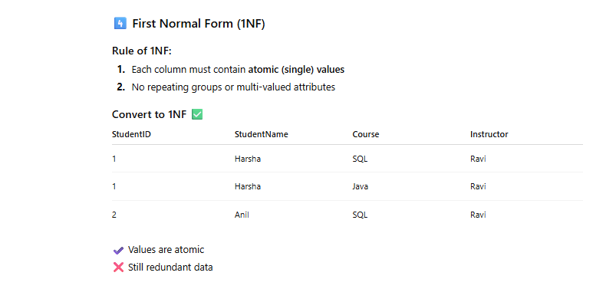
Introduction to RDBMS
Database Normalization

Slide 54
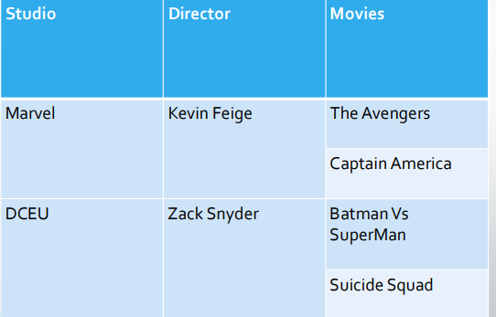
Introduction to RDBMS
Concepts of RDBMS
Database Normalization
This table contains Attribute values
which are not single. This is not in
Normalised form.
• To make it into 1NF we have to
decompose table into atomic
elements.

Slide 55
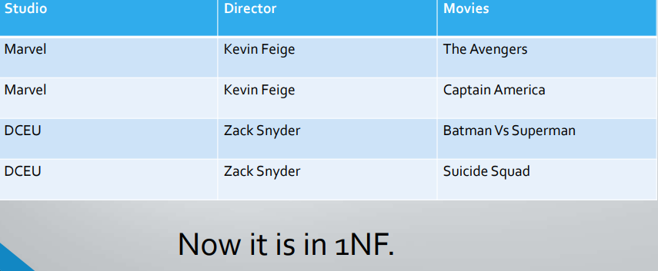
Introduction to RDBMS
Database Normalization

Slide 56
Introduction to RDBMS
Concepts of RDBMS
Database Normalization - 2NF
It should be in the First Normal form.
And, it should not have Partial Dependency.
What is Partial Dependency?
When a table has a primary key that is made up of two or more columns, then all the columns(not included in the primary key) in that table should depend on the entire primary key and not on a part of it. If any column(which is not in the primary key) depends on a part of the primary key then we say we have Partial dependency in the table.

Slide 57
Introduction to RDBMS
Concepts of RDBMS
Database Normalization - 2NF
Name | RollNO | Branch | language
Sai | 21 | CSE | telugu
Sai | 21 | CSE | english
Shiva | 22 | AIML | english
Shiva | 22 | AIML | hindi
Raju | 24 | DS | english
Raju | 24 | DS | hindi

Slide 58
Introduction to RDBMS
Concepts of RDBMS
Database Normalization - 2NF
Name | RollNo | Branch
Sai | 21 | CSE
Shiva | 22 | AIML
Raju | 24 | DS
Roll No | language
21 | telugu
21 | english
22 | english
22 | hindi
24 | english
24 | hindi

Slide 59
Introduction to RDBMS
Concepts of RDBMS
Database Normalization – 3NF
A table is said to be in the Third Normal Form when,
It satisfies the First Normal Form and the Second Normal form.
And, it doesn't have Transitive Dependency.
What is Transitive Dependency?
In a table we have some column that acts as the primary key and other columns depends on this column. But what if a column that is not the primary key depends on another column that is also not a primary key or part of it? Then we have Transitive dependency in our table.

Slide 60
Introduction to RDBMS
Concepts of RDBMS
Database Normalization - 3NF
Name | RollNo | Branch | fee
Sai | 21 | CSE | 30000
Shiva | 22 | AIML | 20000
Ramesh | 23 | DS | 10000
Suresh | 24 | ECE | 5000

Slide 61
Introduction to RDBMS
Concepts of RDBMS
Database Normalization - 3NF
Name | RollNo | Branch
Sai | 21 | CSE
Shiva | 22 | AIML
Ramesh | 23 | DS
Suresh | 24 | ECE
Branch | fee
CSE | 30000
AIML | 20000
DS | 10000
ECE | 5000

Slide 62
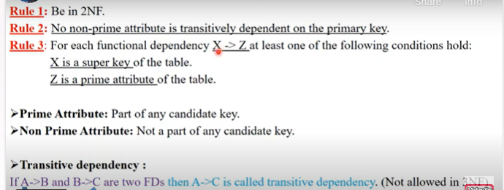
Introduction to RDBMS
Concepts of RDBMS
Database Normalization – 3NF

Slide 63
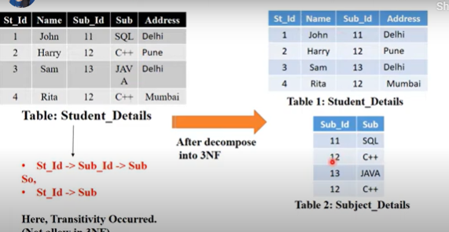
Introduction to RDBMS
Concepts of RDBMS
Database Normalization – 3NF

Slide 64
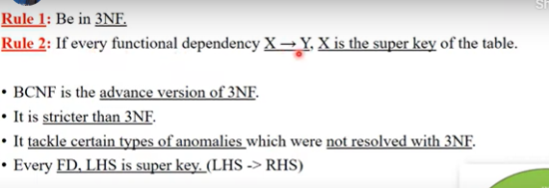
Introduction to RDBMS
Concepts of RDBMS
Database Normalization - Boyce Codd Normal Form (BCNF) – 3.5NF

Slide 65
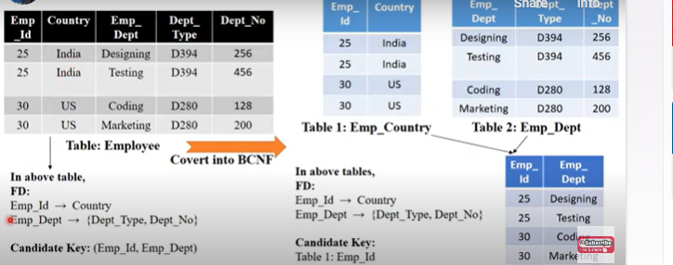
Introduction to RDBMS
Concepts of RDBMS
Database Normalization 3.5NF

Slide 66
Introduction to RDBMS
Concepts of RDBMS
Database Normalization 3.5NF
Roll NO | Std-name | Branch-id | Branch-Name
1 | Sai | 121 | cse
2 | Shiva | 122 | AIML
3 | Ramesh | 123 | DS
4 | Raju | 121 | cse

Slide 67
Introduction to RDBMS
Concepts of RDBMS
Database Normalization 3.5NF
Roll NO | Std-name
1 | Sai
2 | Shiva
3 | Ramesh
4 | Raju
Branch-id | Branch-Name
121 | cse
122 | AIML
123 | DS

Slide 68
Introduction to RDBMS
Database Normalization – 4NF
A relation R is in 4NF if and only if the following conditions are satisfied:
1. It should be in the Boyce-Codd Normal Form (BCNF). 2. The table should not have any Multi-valued Dependency.

Slide 69
Introduction to RDBMS
Database Normalization – 4NF
Std-id | Course | hobby
1 | CSE | dancing
2 | ECE | cricket
3 | AIML | singing
Std-id | Course
1 | CSE
2 | ECE
3 | AIML
Std-id | hobby
1 | dancing
2 | cricket
3 | singing

Slide 70
Introduction to RDBMS
Database Normalization – 5NF
A relation R is in 5NF if and only if it satisfies the following conditions:
1. R should be already in 4NF. 2. It cannot be further non loss decomposed (join dependency).

Slide 71
Introduction to RDBMS
Database Normalization – 5NF
subject | faculty | year
c | Sai | 1
c | shiva | 1
Java | raju | 2
dbms | Nagendra | 3
subject | faculty
c | Sai
c | shiva
Java | raju
dbms | Nagendra
faculty | year
Sai | 1
shiva | 1
raju | 2
Nagendra | 3
subject | year
c | 1
c | 1
Java | 2
dbms | 3

Slide 72
Introduction to RDBMS
ER Diagram
What is an ER Model?
An Entity-Relationship (ER) Model is a graphical representation of a database that shows:
Entities (things of interest)
Their attributes (properties)
Relationships between entities
It helps design the conceptual schema of a database before implementation.

Slide 73
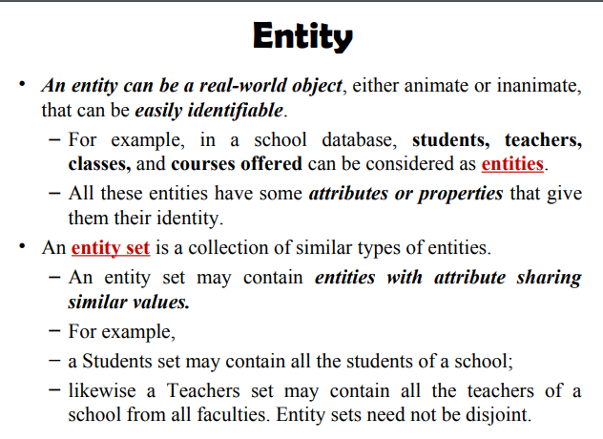
Introduction to RDBMS
Concepts of RDBMS

Slide 74
Introduction to RDBMS
Concepts of RDBMS
Components of ER Model
A. Entities
An entity is a real-world object or concept that can be identified.
Can be tangible (person, product) or intangible (course, event).
Represented as a rectangle in ER diagrams.
Examples:
Employee
Department
Student
Types of Entities:
Strong Entity – Has a primary key. Example: Employee with emp_id.
Weak Entity – Depends on another entity and has a partial key. Example: Dependent of an employee.

Slide 75
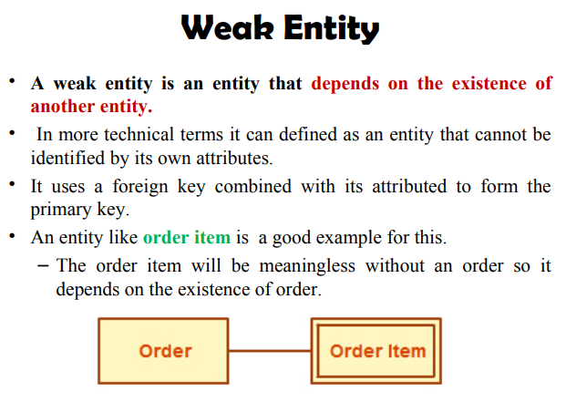
Introduction to RDBMS

Slide 76
Introduction to RDBMS
Concepts of RDBMS
Components of ER Model
Attributes
Attributes are properties of entities or relationships.
Represented as ellipses connected to the entity.
Types of Attributes:
Simple – Cannot be divided further (e.g., first_name).
Composite – Can be divided into sub-parts (e.g., full_name → first_name + last_name).
Derived – Calculated from other attributes (e.g., age from date_of_birth).
Key Attribute – Uniquely identifies an entity (e.g., emp_id).

Slide 77
Introduction to RDBMS
Concepts of RDBMS
Components of ER Model
Relationships
A relationship shows how entities are related.
Represented as a diamond in ER diagrams.
Examples:
Employee works in Department
Student enrolled in Course

Slide 78
Introduction to RDBMS
Components of ER Model
Cardinality
Cardinality defines the number of instances of one entity that can be associated with instances of another entity.
Types of Cardinality:
One-to-One (1:1) – One entity instance relates to exactly one instance of another entity.
Example: Each Employee has one Employee ID Card.
One-to-Many (1:N) – One entity instance relates to many instances of another entity.
Example: One Department has many Employees.
Many-to-Many (M:N) – Many instances of one entity relate to many instances of another.
Example: Student enrolls in many Courses and a Course has many Students.

Slide 79
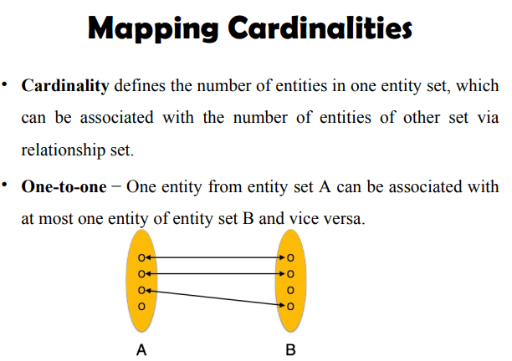
Introduction to RDBMS
Concepts of RDBMS
Components of ER Model

Slide 80
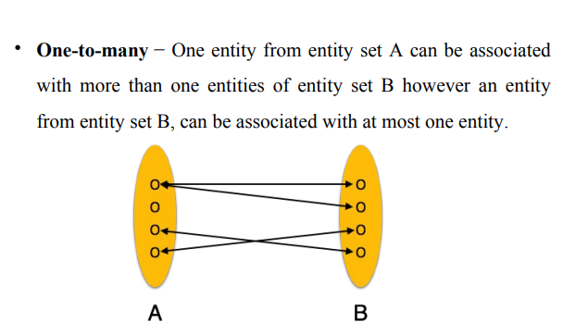
Introduction to RDBMS
Concepts of RDBMS
Components of ER Model

Slide 81
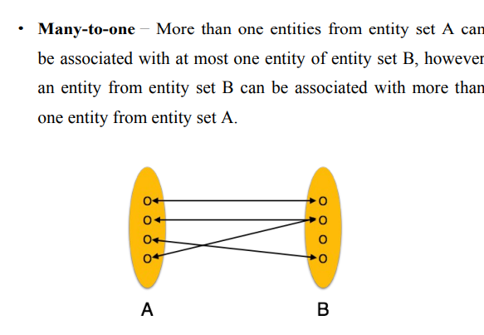
Introduction to RDBMS
Components of ER Model

Slide 82
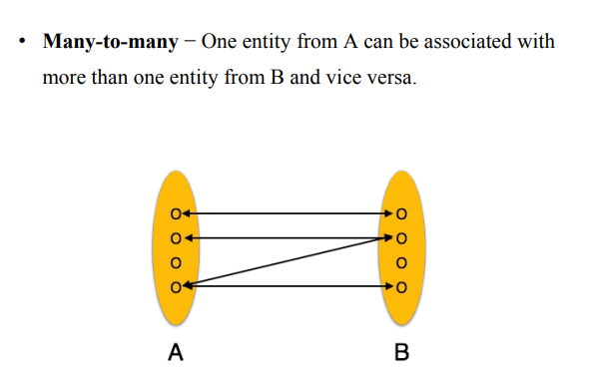
Introduction to RDBMS
Components of ER Model

Slide 83
Introduction to RDBMS
Concepts of RDBMS
Components of ER Model
University Database
Entities: Student, Course, Department, Enrollment Relationships:
Student enrolls_in Course (M:N)
Department offers Course (1:N)
Attributes:
Student: student_id (PK), name, dob, email
Course: course_id (PK), course_name, credits
Department: dept_id (PK), dept_name, location
Enrollment: student_id (FK), course_id (FK), enrollment_date
Diagram Concept:
[Department] 1 --- N [Course] M --- N [Student]
| |
dept_id (PK) course_id (PK)

Slide 84
Introduction to RDBMS
ER Diagram
Library Management System
Entities: Book, Member, Loan
Relationships:
Member borrows Book (M:N)
Attributes:
Book: book_id (PK), title, author, publisher
Member: member_id (PK), name, email
Loan: loan_id (PK), book_id (FK), member_id (FK), loan_date, return_date
Diagram Concept:
[Member] M --- N [Book]
\ /
\ /
[Loan]

Slide 85
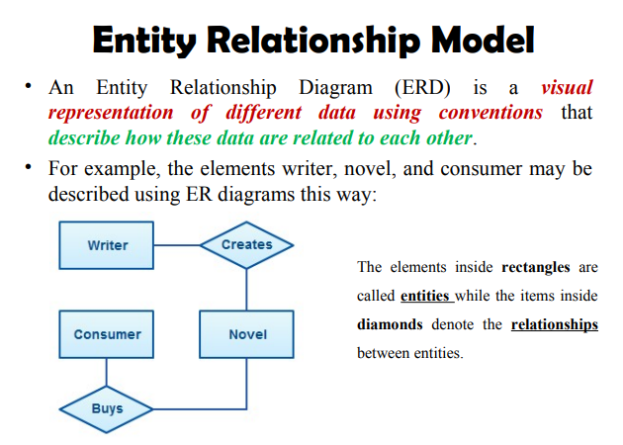
Introduction to RDBMS
ER Diagram

Slide 86
Introduction to RDBMS
Logical and Physical Database Design
Logical design is about what the system needs → the business requirements. It defines structure, relationships, and rules without worrying about hardware or DBMS details.
Main Focus
Entities (tables)
Attributes (columns)
Primary keys & foreign keys
Relationships (1–1, 1–M, M–N)
Normalization (1NF, 2NF, 3NF, BCNF)
ER diagrams
Constraints (unique, not null, check)

Slide 87
Introduction to RDBMS
Logical and Physical Database Design
Goal
Create a logical data model that accurately represents real-world business objects.
Example
For an e-commerce system:
Entities: Customer, Orders, Product Relationships: Customer → Orders (1:M), Orders → Product (M:N)

Slide 88
Introduction to RDBMS
Logical and Physical Database Design
Physical Database Design
Physical design is about how the database will be implemented in a specific DBMS.
It converts the logical model into a technical implementation plan.
Main Focus
Table creation SQL
Data types
Indexing
Partitions
Sharding / Replication
Physical storage (disk, memory)
Performance tuning
Denormalization (if needed for speed)
File organization (clustered / non-clustered)

Slide 89
Introduction to RDBMS
Concepts of RDBMS
Logical and Physical Database Design
Goal
Optimize for:
Performance
Storage
Efficiency
Scalability
Example
Choosing:
VARCHAR(255) for customer name
Creating an index on email
Partitioning orders table by date
Denormalizing product description for faster read

Slide 90
Introduction to RDBMS
Logical and Physical Database Design
Goal
Optimize for:
Performance
Storage
Efficiency
Scalability
Example
Choosing:
VARCHAR(255) for customer name
Creating an index on email
Partitioning orders table by date
Denormalizing product description for faster read

Slide 91
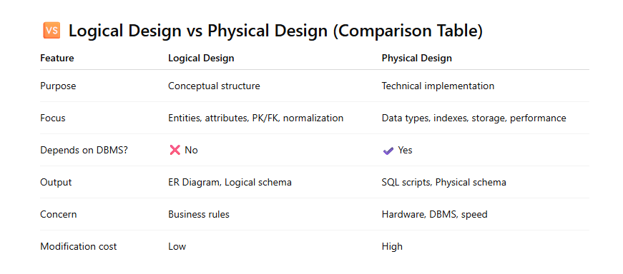
Introduction to RDBMS
Logical and Physical Database Design

Slide 92
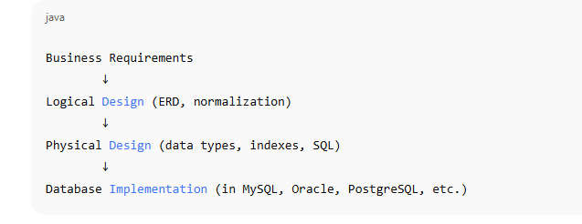
Introduction to RDBMS
Logical and Physical Database Design

Slide 93
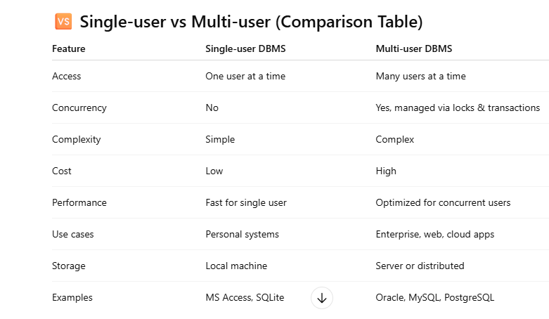
Introduction to RDBMS
RDBMS Architectures
Single-user vs Multi-user Systems

Slide 94
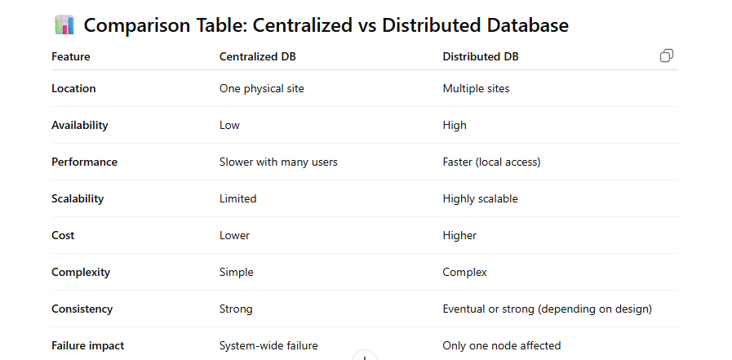
Introduction to RDBMS
Centralized vs Distributed Databases

Slide 95
Introduction to RDBMS
Concepts of RDBMS
Client–Server Architecture in RDBMS
Client–Server architecture is a database computing model where the database server stores, manages, and processes data, and the client sends requests to access or modify data.
The relationship works in a request–response manner.

Slide 96
Introduction to RDBMS
Client–Server Architecture in RDBMS
What is Client?
A client is an application or user interface that sends SQL queries to the database server.
Examples:
SQL Developer
MySQL Workbench
Web application (UI)
Mobile app sending API requests

Slide 97
Introduction to RDBMS
Client–Server Architecture in RDBMS
2. What is Server?
A server is a powerful machine running the RDBMS software (e.g., MySQL, Oracle DB, PostgreSQL) that stores the database and executes SQL queries.
3. How Client–Server Works
Client sends SQL request (SELECT/INSERT/UPDATE/DELETE).
Server processes the query using SQL engine.
Server returns the result set to the client.
Client displays/uses the data.

Slide 98
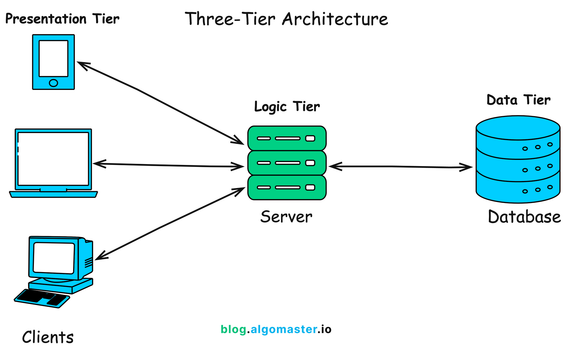
Introduction to RDBMS
Client–Server Architecture in RDBMS

Slide 99
Introduction to RDBMS
Client–Server Architecture in RDBMS
Advantages of Client–Server Architecture
✔️ Centralized Control
All data is stored and managed on server → better integrity & security.
✔️ Scalability
More clients can be added easily.
✔️ Data Sharing
Multiple clients access the same database concurrently.
✔️ Security
Server controls authentication, authorization, roles, privileges.
✔️ Backup & Recovery
Centralized backup and maintenance is easier.

Slide 100
Introduction to RDBMS
Disadvantages
❌ Single Point of Failure
If the DB server is down → system unavailable.
❌ Network Dependency
Slow network = slow database response.
❌ Server Load
Many clients → heavy server load → performance issues.
Examples of Client–Server RDBMS
MySQL server with PHP/Java clients
Oracle DB with enterprise apps
PostgreSQL with web services
Microsoft SQL Server with .NET clients

Slide 101
Introduction to RDBMS
Data Integrity and Transactions
Data Integrity in RDBMS
Data Integrity refers to the accuracy, correctness, and consistency of data stored in a database throughout its lifecycle.
It ensures that:
Data is valid
Data is reliable
Data is consistent across tables and relationships

Slide 102
Introduction to RDBMS
Data Integrity and Transactions
Types of Data Integrity
1. Entity Integrity
Ensures each table has a unique primary key and no row can have a NULL primary key.
📌 Example: EmployeeID cannot be NULL or duplicate.

Slide 103
Introduction to RDBMS
Data Integrity and Transactions
2. Referential Integrity
Ensures that foreign keys reference valid primary keys in another table.
📌 Example: Orders.CustomerID must exist in Customer.CustomerID.
If a customer is deleted, associated orders must be:
prevented from deletion (RESTRICT), or
deleted automatically (CASCADE), or
set to NULL (SET NULL)

Slide 104
Introduction to RDBMS
Data Integrity and Transactions
3. Domain Integrity
Ensures data values fall within a valid range or format.
Enforced through:
Data types (INT, VARCHAR)
CHECK constraints
Default values
NOT NULL constraints
📌 Example: Salary must be > 0, Age must be between 18–60.

Slide 105
Introduction to RDBMS
Data Integrity and Transactions
4. User-Defined Integrity
Custom business rules defined by users.
📌 Example: “Withdrawal cannot exceed account balance.”

Slide 106
Introduction to RDBMS
Data Integrity and Transactions
Transactions in RDBMS
A transaction is a unit of work that consists of one or more SQL operations that must be completed fully or not at all.
Examples of transactions:
Bank transfer (debit + credit)
Insert order + update inventory
Multiple table updates

Slide 107
Introduction to RDBMS
Data Integrity and Transactions
ACID Properties of Transactions
These properties ensure reliable transaction processing.
Atomicity
All statements in a transaction succeed or all fail.
If one operation fails → the entire transaction rolls back.
📌 Example: If debit succeeds but credit fails → reverse debit (rollback).

Slide 108
Introduction to RDBMS
Data Integrity and Transactions
2. Consistency
Transaction must bring the database from one valid state to another.
All rules, constraints, and triggers must be followed.
📌 Example: Account balance cannot become negative if constraint is applied.
3. Isolation
Multiple transactions must not interfere with each other.
Results of one transaction should not be visible to another until committed.
📌 Example: Two users booking the same seat simultaneously → prevented through isolation.

Slide 109
Introduction to RDBMS
Data Integrity and Transactions
4. Durability
Once a transaction is committed, the changes are permanent, even after system failure.
📌 Example: After COMMIT, data remains safe even after a crash.

Slide 110
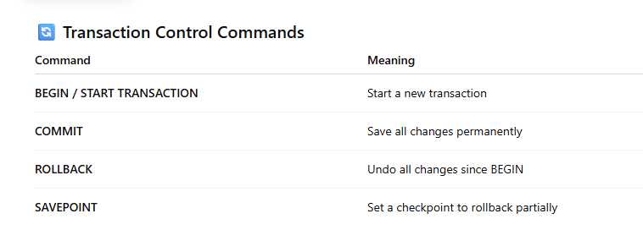
Introduction to RDBMS
Concepts of RDBMS
Data Integrity and Transactions

Slide 111
Introduction to RDBMS
Data Integrity and Transactions
Difference Between Data Integrity & Transactions
Feature | Data Integrity | Transactions
Purpose | Ensure correctness of data | Ensure reliable execution of operations
Enforced by | Keys, constraints | ACID properties
Level | Data level | Operation level
Focus | Prevent invalid data | Prevent partial updates

Slide 112
Introduction to RDBMS
Locking and Concurrency Control
When multiple users access the database at the same time, their operations may conflict.
Concurrency Control ensures that multiple transactions can run simultaneously without causing:
Data inconsistency
Lost updates
Dirty reads
Deadlocks
Locking is the most commonly used mechanism to control concurrency.

Slide 113
Introduction to RDBMS
Concepts of RDBMS
Locking and Concurrency Control
What is Locking?
Locking is a technique used by the DBMS to restrict access to data items when a transaction is reading or modifying them.
It prevents other transactions from making conflicting changes.

Slide 114
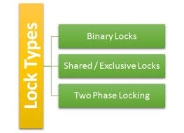
Introduction to RDBMS
Locking and Concurrency Control

Slide 115
Introduction to RDBMS
Locking and Concurrency Control
Types of Locks
Shared Lock (S-Lock) / Read Lock
Allows multiple transactions to read the same data item.
But no transaction is allowed to modify it.
📌 Example: Two users reading account balance → allowed.
2. Exclusive Lock (X-Lock) / Write Lock
Only one transaction can hold the lock.
No other transaction can read or write the locked data.
📌 Example: When updating a balance, only one transaction can access that row.

Slide 116
Introduction to RDBMS
Locking and Concurrency Control
Two-Phase Locking (2PL)
A standard protocol used by most RDBMS to maintain serializability.
Phase 1: Growing Phase
Transaction acquires locks but cannot release any.
Phase 2: Shrinking Phase
Transaction releases locks and cannot acquire new ones.
This ensures consistency and prevents interleaving issues.

Slide 117
Introduction to RDBMS
Locking and Concurrency Control
Lock Granularity
The level at which the lock is applied.
Row-level lock – locks individual rows
Page-level lock – locks a page (block of rows)
Table-level lock – locks entire table
Database-level lock – very rare; entire DB locked
More granularity → higher concurrency but higher overhead.

Slide 118
Introduction to RDBMS
Locking and Concurrency Control
Problems in Concurrency (Why locking is required?)
1. Lost Update
Two transactions update the same data, and one overwrites the other's update.
2. Dirty Read
A transaction reads uncommitted data of another transaction.
3. Non-Repeatable Read
The same query within a transaction gives different results because another transaction updated the data.
4. Phantom Read
New rows appear when the same query is run again in a transaction.

Slide 119
Introduction to RDBMS
Locking and Concurrency Control
Deadlock
Occurs when two or more transactions wait for each other’s locks, and none can proceed.
Example:
T1 locks Row A, waits for Row B
T2 locks Row B, waits for Row A
DBMS must detect or prevent deadlocks.
Deadlock Handling
Deadlock Detection & Timeout (RDBMS auto-detects and rolls back one transaction)
Deadlock Prevention (ordering of resources)

Slide 120
Introduction to RDBMS
Locking and Concurrency Control
Concurrency Control Techniques
✔️ 1. Lock-based Protocols
Shared and Exclusive locks
Two-Phase Locking (2PL)
✔️ 2. Timestamp-based Protocols
Each transaction gets a timestamp. Older transactions get priority.
✔️ 3. Optimistic Concurrency Control (OCC)
No locks during execution
Validation at commit time
Used in low-conflict systems (e.g., web apps)
✔️ 4. Multiversion Concurrency Control (MVCC)
Creates multiple versions of data
Readers don’t block writers, and writers don’t block readers Used in PostgreSQL, Oracle, MySQL (InnoDB), etc.

Slide 121
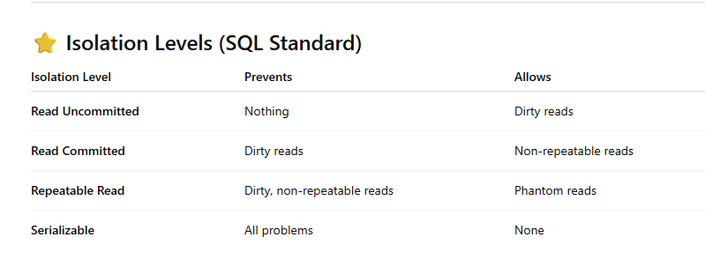
Introduction to RDBMS
Locking and Concurrency Control

Slide 122
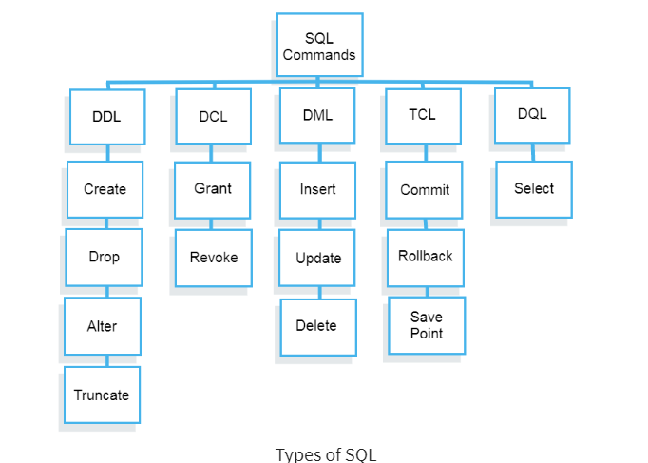
Introduction to RDBMS
SQL

Slide 123
Introduction to RDBMS
SQL
What is SQL Language?
SQL (Structured Query Language) is a standard programming language used to store, retrieve, manage, and manipulate data in a relational database management system (RDBMS).
It is the primary language used with databases such as:
MySQL
Oracle
SQL Server
PostgreSQL
SQLite
SQL allows users to perform operations like:
Creating tables
Inserting data
Updating data
Deleting data
Querying data
Controlling access

Slide 124
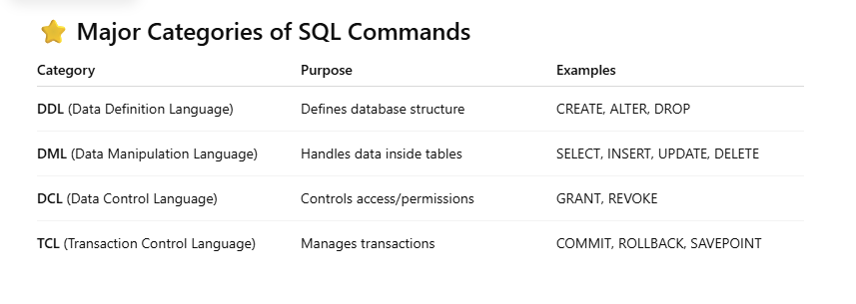
Introduction to RDBMS
SQL
Key Features of SQL
Declarative language – You specify what to do, not how to do it.
Standardized (ANSI/ISO) – Works across most RDBMS with minor variations.
Easy to learn and use – English-like commands.
Supports powerful operations – Joins, indexing, aggregation, subqueries.

Slide 125
Introduction to RDBMS
SQL
DDL – Data Definition Language
DDL (Data Definition Language) is a subset of SQL used to define, create, modify, and delete database structures—not the data itself. DDL statements change the schema of the database.
Common DDL commands:
CREATE
ALTER
DROP
TRUNCATE
RENAME
DDL commands are usually auto-commit, meaning changes are permanent immediately.

Slide 126
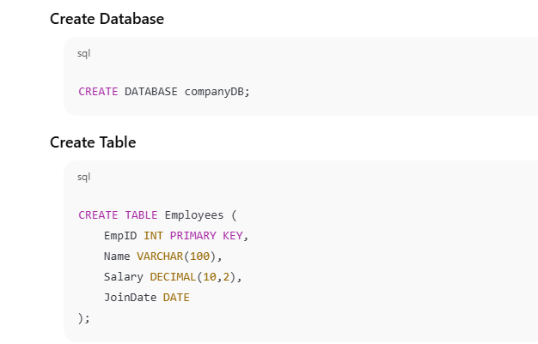
Introduction to RDBMS
SQL
Database and Table Operations
⭐ CREATE (Database & Table)
Used to create databases or tables.

Slide 127
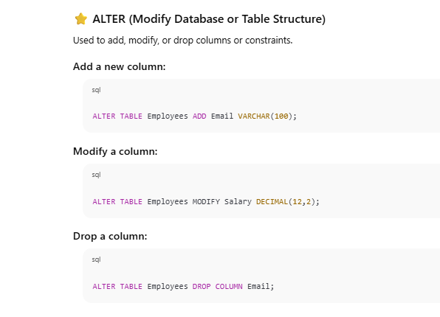
Introduction to RDBMS
SQL - ALTER

Slide 128
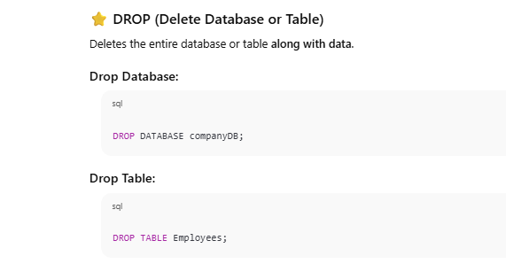
Introduction to RDBMS
SQL - DELETE

Slide 129
Introduction to RDBMS
SQL – Create Index
CREATE INDEX and DROP INDEX
⭐ What is an Index?
Indexes improve query performance.
Work like an index in a book—helps you find data faster.
But they slow down INSERT, UPDATE, DELETE because index also needs updating.

Slide 130
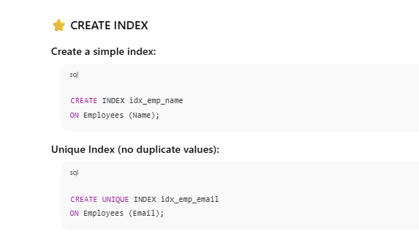
Introduction to RDBMS
SQL – Create Index

Slide 131
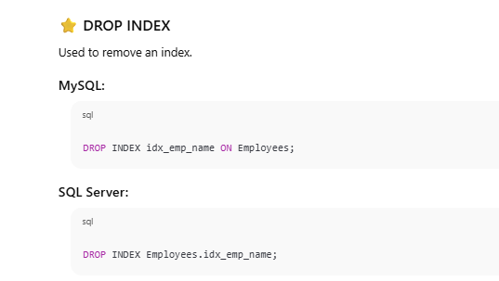
Introduction to RDBMS
SQL – Create Index

Slide 132
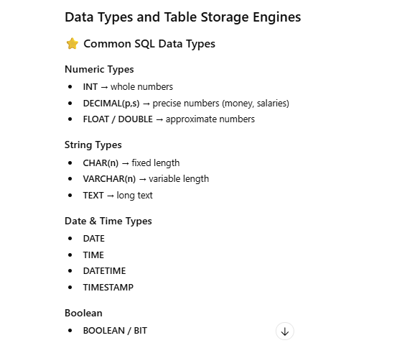
Introduction to RDBMS
SQL – Data Types and Table Storage Engines

Slide 133
Introduction to RDBMS
SQL – DCL - Data Control Language
⭐ DCL – Data Control Language
DCL (Data Control Language) is a subset of SQL used to control access, permissions, and security of database objects.
DCL ensures:
Only authorized users can access the database.
Sensitive data is protected.
Permissions are assigned/granted and removed/revoked when needed.
The two main DCL commands are:
GRANT
REVOKE

Slide 134
Introduction to RDBMS
SQL – DCL - Data Control Language
⭐ User and Permission Management
Database security involves:
Creating users
Assigning privileges
Removing privileges
Destroying users
Using roles for easier permission management

Slide 135
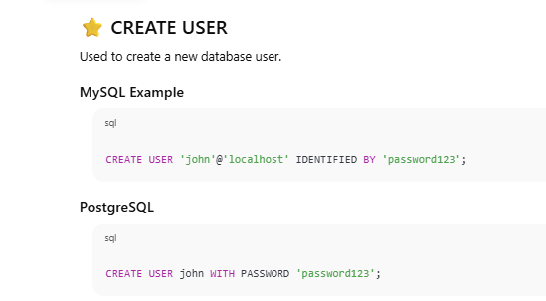
Introduction to RDBMS
SQL – DCL - Data Control Language

Slide 136
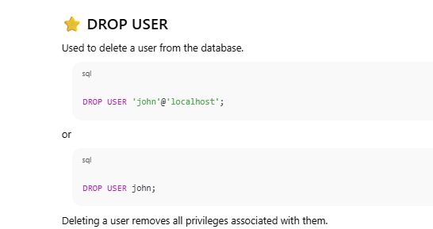
Introduction to RDBMS
SQL – DCL - Data Control Language

Slide 137
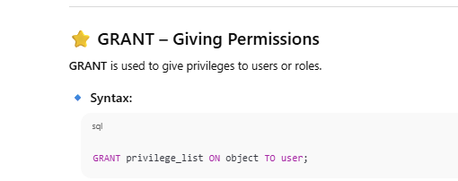
Introduction to RDBMS
SQL – DCL - Data Control Language

Slide 138
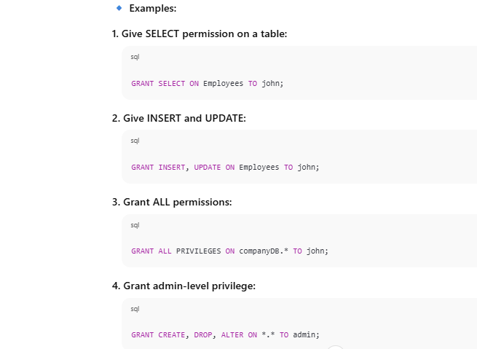
Introduction to RDBMS
SQL – DCL - Data Control Language

Slide 139
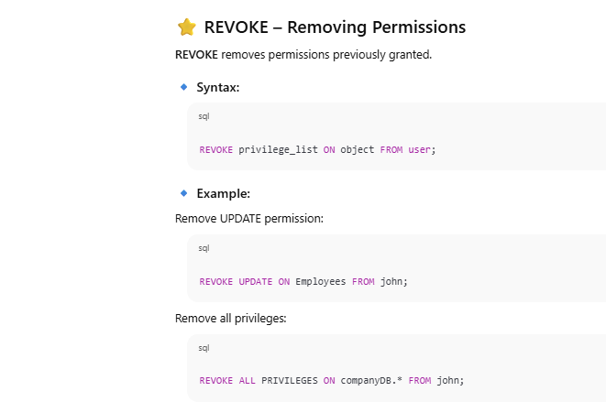
Introduction to RDBMS
SQL – DCL - Data Control Language

Slide 140
Introduction to RDBMS
SQL – DCL - Data Control Language
⭐ Roles and Privileges
A Role is a collection of privileges grouped together. Roles simplify permission management, especially for many users.
Why Roles are useful:
Assign a set of permissions at once.
Reduce repeated GRANT commands.
Easier to manage large teams.

Slide 141
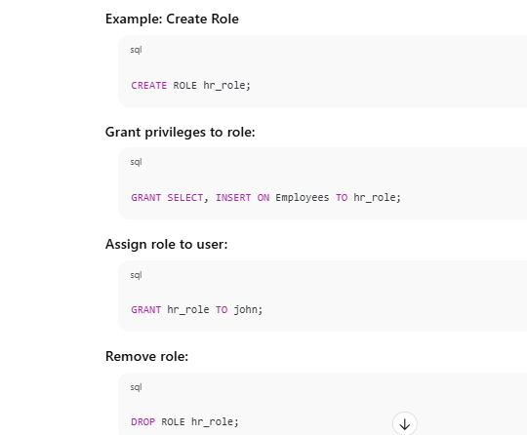
Introduction to RDBMS
SQL – DCL - Data Control Language

Slide 142
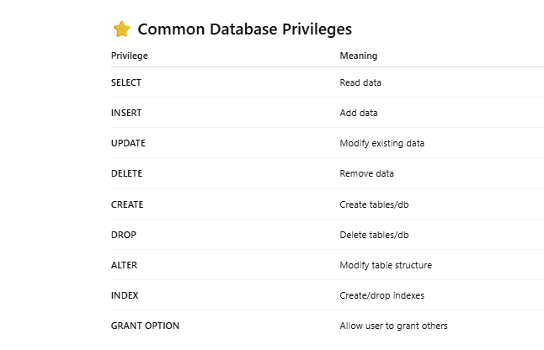
Introduction to RDBMS
SQL – Create Index

Slide 143
Introduction to RDBMS
SQL – DML – Data Manipulation Language
DML is a subset of SQL used to manage and manipulate data stored inside tables of a relational database.
It deals with CRUD operations:
Create → INSERT
Read → SELECT (technically a query, not DML in some classifications)
Update → UPDATE
Delete → DELETE
DML operations affect table rows (records).

Slide 144
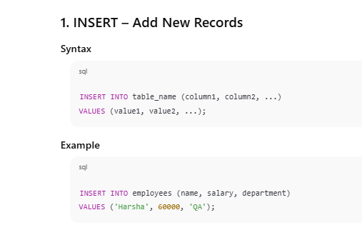
Introduction to RDBMS
SQL – DML – Data Manipulation Language

Slide 145
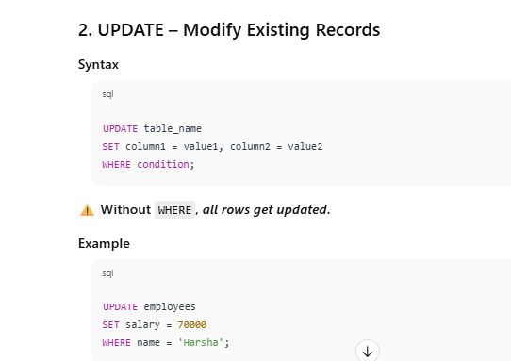
Introduction to RDBMS
SQL – DML – Data Manipulation Language

Slide 146
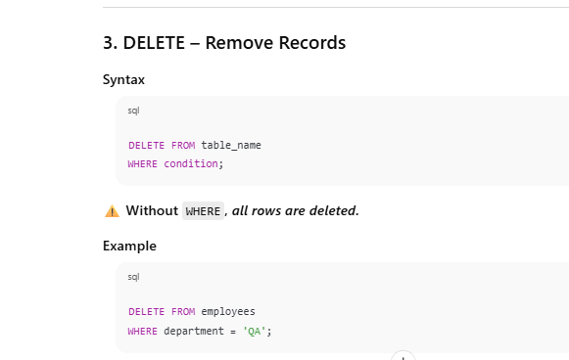
Introduction to RDBMS
SQL – DML – Data Manipulation Language

Slide 147
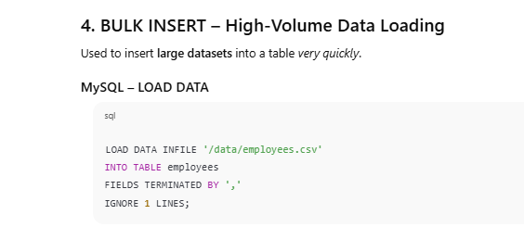
Introduction to RDBMS
SQL – DML – Data Manipulation Language

Slide 148
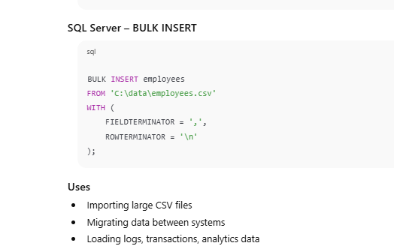
Introduction to RDBMS
SQL – DML – Data Manipulation Language

Slide 149
Introduction to RDBMS
SQL – DML – Data Manipulation Language
Data Import/Export Techniques
Import Methods
LOAD DATA INFILE (MySQL)
BULK INSERT (SQL Server)
COPY command (PostgreSQL)
Database migration tools (DBeaver, Workbench)
ETL pipelines (Airflow, SSIS)
Export Methods
SELECT INTO OUTFILE (MySQL)
bcp utility (SQL Server)
PostgreSQL COPY TO
Export as CSV/JSON/XML from GUI tools

Slide 150

Introduction to RDBMS
SQL – DQL – Data Query Language
DQL consists mainly of the SELECT command used to query, filter, sort, group, and join data from tables.
DQL focuses on retrieving data, not modifying it.
1. Basic Data Retrieval
SELECT Statements

Slide 151

Introduction to RDBMS
SQL – DML – Data Manipulation Language

Slide 152

Introduction to RDBMS
SQL – DML – Data Manipulation Language

Slide 153

Introduction to RDBMS
SQL – DML – Data Manipulation Language

Slide 154




Introduction to RDBMS
SQL – Advanced Data Retrieval

Slide 155
Introduction to RDBMS
SQL – Advanced Data Retrieval
INNER JOIN: Returns records that have matching values in both tables
LEFT (OUTER) JOIN: Returns all records from the left table, and the matched records from the right table
RIGHT (OUTER) JOIN: Returns all records from the right table, and the matched records from the left table
FULL (OUTER) JOIN: Returns all records when there is a match in either left or right table

Slide 156

Introduction to RDBMS
SQL – Inner Join

Slide 157

Introduction to RDBMS
SQL – Inner Join

Slide 158

Introduction to RDBMS
SQL – LEFT JOIN (LEFT OUTER JOIN)
Unmatched employee rows show NULL for departments.

Slide 159

Introduction to RDBMS
SQL – RIGHT JOIN (RIGHT OUTER JOIN)

Slide 160

Introduction to RDBMS
SQL FULL JOIN (FULL OUTER JOIN)

Slide 161

Introduction to RDBMS
SQL FULL JOIN (FULL OUTER JOIN)

Slide 162
Introduction to RDBMS
SQL CROSS JOIN
Returns the Cartesian product of two tables.
Every row of table A is combined with every row of table B.
If employees has 4 rows and departments has 3 → Output = 4 × 3 = 12 rows
Query

Slide 163

Introduction to RDBMS
SQL CROSS JOIN

Slide 164

Introduction to RDBMS
Subqueries and Correlated Subqueries

Slide 165

Introduction to RDBMS
Subqueries and Correlated Subqueries

Slide 166
Introduction to RDBMS
Subqueries and Correlated Subqueries
What is a Subquery?
A subquery (also called an inner query) is a query written inside another query.
It is executed once, and the result is passed to the outer query.
Types of Subqueries
Subqueries can return:
A single value (scalar subquery)
A single row
Multiple rows
A table (entire result set)

Slide 167
Introduction to RDBMS
Subqueries and Correlated Subqueries
What is a Correlated Subquery?
A correlated subquery depends on the outer query.
It is executed once for every row of the outer query.
It refers to a column from the outer query.
Important
The correlated subquery cannot run independently.

Slide 168

Introduction to RDBMS
Subqueries and Correlated Subqueries

Slide 169

Introduction to RDBMS
Subqueries and Correlated Subqueries

Slide 170

Introduction to RDBMS
Subqueries and Correlated Subqueries

Slide 171

Introduction to RDBMS
Subqueries and Correlated Subqueries

Slide 172
Introduction to RDBMS
UNION, INTERSECT, and EXCEPT Clauses
Set Operators in SQL (RDBMS)
Set operators combine the results of two or more SELECT queries.
The three major set operators are:
✅ 1. UNION
✅ 2. INTERSECT
✅ 3. EXCEPT (also called MINUS in Oracle)

Slide 173
Introduction to RDBMS
UNION, INTERSECT, and EXCEPT Clauses
Rules for All Set Operators
Both SELECT queries must have same number of columns
Columns must have compatible data types
Order of columns must match
Results remove duplicates by default

Slide 174

Introduction to RDBMS
UNION, INTERSECT, and EXCEPT Clauses

Slide 175

Introduction to RDBMS
UNION, INTERSECT, and EXCEPT Clauses

Slide 176

Introduction to RDBMS
UNION, INTERSECT, and EXCEPT Clauses

Slide 177

Introduction to RDBMS
UNION, INTERSECT, and EXCEPT Clauses
What is EXCEPT?
Returns rows from the first table only, excluding common rows.

Slide 178
Introduction to RDBMS
Functions and Expressions
⭐ 1. Functions and Expressions in SQL
Functions help manipulate data. They can be:
Scalar functions → Return single value per row
Aggregate functions → Return single value for a group of rows
Expressions combine values using operators or functions.

Slide 179


Introduction to RDBMS
Functions and Expressions

Slide 180

Introduction to RDBMS
Functions and Expressions

Slide 181

Introduction to RDBMS
Functions and Expressions

Slide 182


Introduction to RDBMS
Functions and Expressions
⭐ 3. Aggregate Functions
Aggregate functions operate on a group of rows and return one result.

Slide 183


Introduction to RDBMS
Functions and Expressions

Slide 184

Introduction to RDBMS
Functions and Expressions
CASE Expressions and Conditional Logic
CASE works like IF / ELSE in SQL.

Slide 185

Introduction to RDBMS
Functions and Expressions

Slide 186

Introduction to RDBMS
Functions and Expressions

Slide 187

Introduction to RDBMS
Functions and Expressions

Slide 188

Introduction to RDBMS
Functions and Expressions

Slide 189


Introduction to RDBMS
Functions and Expressions

Slide 190


Introduction to RDBMS
Functions and Expressions

Slide 191
Introduction to RDBMS
TCL - Transaction Control Language
⭐ 1. What is TCL (Transaction Control Language)?
TCL commands are used to manage transactions in a database. A transaction is a logical unit of work that must be either fully completed or fully undone to maintain data integrity.
Key TCL commands:
BEGIN TRANSACTION (or START TRANSACTION)
COMMIT
ROLLBACK
SAVEPOINT
RELEASE SAVEPOINT

Slide 192

Introduction to RDBMS
TCL - Transaction Control Language

Slide 193

Introduction to RDBMS
TCL - Transaction Control Language

Slide 194

Introduction to RDBMS
TCL - Transaction Control Language

Slide 195

Introduction to RDBMS
TCL - Transaction Control Language

Slide 196

Introduction to RDBMS
TCL - Transaction Control Language

Slide 197

Introduction to RDBMS
TCL - Transaction Control Language

Slide 198

Introduction to RDBMS
TCL - Transaction Control Language

Slide 199
Introduction to RDBMS
TCL - Transaction Control Language
5. Transaction Log Management
Databases maintain a transaction log to track all changes.
Purpose:
Recover committed transactions after crash
Undo uncommitted or failed transactions
Operations like COMMIT or ROLLBACK use this log to ensure ACID compliance.

Slide 200

Introduction to RDBMS
TCL - Transaction Control Language

Slide 201
Introduction to RDBMS
TCL - Transaction Control Language
7. Key Points
Implicit transactions: Auto-commit every statement
Explicit transactions: Start with BEGIN, end with COMMIT or ROLLBACK
SAVEPOINT: Partial rollback
Transaction log: Ensures durability & recovery

Slide 202
Introduction to RDBMS
Advanced SQL Concepts
⭐ 1. Window Functions Overview
Window functions perform calculations across a set of rows related to the current row, without collapsing rows like aggregate functions do.
They use the OVER() clause to define the “window” of rows.
Key points:
Do not reduce the number of rows (unlike GROUP BY)
Can perform ranking, cumulative, moving, or lag/lead calculations

Slide 203

Introduction to RDBMS
Advanced SQL Concepts

Slide 204

Introduction to RDBMS
Advanced SQL Concepts

Slide 205

Introduction to RDBMS
Advanced SQL Concepts

Slide 206

Introduction to RDBMS
Advanced SQL Concepts

Slide 207

Introduction to RDBMS
Advanced SQL Concepts

Slide 208

Introduction to RDBMS
Advanced SQL Concepts

Slide 209

Introduction to RDBMS
Advanced SQL Concepts

Slide 210

Introduction to RDBMS
Advanced SQL Concepts

Slide 211
Introduction to RDBMS
Advanced SQL Concepts
⭐ 1. What is Performance Tuning in RDBMS?
Performance tuning is the process of improving the efficiency of SQL queries and database operations to ensure fast response time and optimal resource usage.
Goals:
Reduce query execution time
Reduce CPU, memory, and I/O usage
Ensure scalability for large datasets

Slide 212
Introduction to RDBMS
Advanced SQL Concepts
⭐ 2. Indexing Strategies and Types
Indexes improve query performance by allowing the database to locate rows quickly instead of scanning the entire table.

Slide 213

Introduction to RDBMS
Advanced SQL Concepts

Slide 214

Introduction to RDBMS
Advanced SQL Concepts

Slide 215
Introduction to RDBMS
Advanced SQL Concepts
⭐ 3. Query Performance Analysis
Steps to analyze and improve query performance:
Identify slow queries
Use DB logs, SHOW FULL PROCESSLIST (MySQL), or SQL Server Query Store
Check execution time
Compare before and after changes
Look for common performance issues:
Full table scans instead of index usage
Large joins without indexes
Excessive sorting or aggregation
Functions on indexed columns (prevents index usage)

Slide 216

Introduction to RDBMS
Advanced SQL Concepts
Key parts of execution plan:
Seq Scan / Table Scan: Full table scan (slow)
Index Scan / Index Seek: Uses index (fast)
Nested Loop / Hash Join: How joins are executed
Estimated Rows: Helps identify inefficiencies

Slide 217

Introduction to RDBMS
Advanced SQL Concepts

Slide 218

Introduction to RDBMS
Advanced SQL Concepts

Slide 219
Introduction to RDBMS
Advanced SQL Concepts
⭐ 6. Best Practices for Query Optimization
Use indexes on frequently searched columns
Avoid **SELECT ***; select only required columns
Avoid functions on indexed columns in WHERE clause
Use JOINs efficiently; avoid unnecessary subqueries
Use EXISTS instead of IN for subquery checks
Analyze execution plan for expensive operations
Consider partitioning large tables
Use caching for repeated queries

Slide 220
Introduction to RDBMS
Advanced SQL Concepts
⭐ 7. Monitoring Tools
MySQL: EXPLAIN, SHOW PROFILE, slow query log
SQL Server: Execution plan, Query Store, Performance Monitor
Oracle: AUTOTRACE, EXPLAIN PLAN
PostgreSQL: EXPLAIN ANALYZE, pg_stat_statements

Slide 221
Introduction to RDBMS
Advanced SQL Concepts
Avoiding SQL Injection Vulnerabilities
⭐ 1. What is SQL Injection?
SQL Injection (SQLi) is a code injection attack where an attacker manipulates input data to execute malicious SQL statements.
It occurs when user input is directly concatenated into SQL queries without validation or sanitization.
Consequences:
Unauthorized access to sensitive data
Bypassing authentication
Data modification or deletion
Full database compromise

Slide 222

Introduction to RDBMS
Advanced SQL Concepts
Avoiding SQL Injection Vulnerabilities

Slide 223

Introduction to RDBMS
Advanced SQL Concepts
Avoiding SQL Injection Vulnerabilities

Slide 224

Introduction to RDBMS
Advanced SQL Concepts
Avoiding SQL Injection Vulnerabilities

Slide 225

Introduction to RDBMS
Advanced SQL Concepts
Avoiding SQL Injection Vulnerabilities

Slide 226

Introduction to RDBMS
Advanced SQL Concepts
Avoiding SQL Injection Vulnerabilities

Slide 227

Introduction to RDBMS
Advanced SQL Concepts
Secure SQL Coding Practices

Slide 228

Introduction to RDBMS
Advanced SQL Concepts
Secure SQL Coding Practices

Slide 229

Introduction to RDBMS
Advanced SQL Concepts
Secure SQL Coding Practices

Slide 230

Introduction to RDBMS
Advanced SQL Concepts
Secure SQL Coding Practices

Slide 231

Introduction to RDBMS
Advanced SQL Concepts
Secure SQL Coding Practices

Slide 232

Introduction to RDBMS
Advanced SQL Concepts
Secure SQL Coding Practices

Slide 233

Introduction to RDBMS
Advanced SQL Concepts
Secure SQL Coding Practices

Slide 234

Introduction to RDBMS
Advanced SQL Concepts
Secure SQL Coding Practices

Slide 235

Introduction to RDBMS
Advanced SQL Concepts
Secure SQL Coding Practices

Slide 236

Introduction to RDBMS
Advanced SQL Concepts
Secure SQL Coding Practices

Slide 237

Introduction to RDBMS
Advanced SQL Concepts
Secure SQL Coding Practices

Slide 238

Introduction to RDBMS
Advanced SQL Concepts
Secure SQL Coding Practices

Slide 239
Introduction to RDBMS
Advanced SQL Concepts
Database Encryption and Data Masking
⭐ 1. DATABASE ENCRYPTION IN RDBMS
Encryption protects data by converting readable data (plaintext) into unreadable form (ciphertext) so unauthorized users cannot access it.
Database encryption happens in two major categories:
⭐ A. Data-at-Rest Encryption
Protects stored data on:
Disk
Backups
Archive files
Database files
There are two main types:

Slide 240

Introduction to RDBMS
Advanced SQL Concepts
Database Encryption and Data Masking

Slide 241

Introduction to RDBMS
Advanced SQL Concepts
Database Encryption and Data Masking

Slide 242

Introduction to RDBMS
Advanced SQL Concepts
Database Encryption and Data Masking

Slide 243

Introduction to RDBMS
Advanced SQL Concepts
Database Encryption and Data Masking

Slide 244

Introduction to RDBMS
Advanced SQL Concepts
Database Encryption and Data Masking

Slide 245

Introduction to RDBMS
Advanced SQL Concepts
Database Encryption and Data Masking

Slide 246

Introduction to RDBMS
Advanced SQL Concepts
Database Encryption and Data Masking

Slide 247

Introduction to RDBMS
Advanced SQL Concepts
Database Encryption and Data Masking

Slide 248
Thank You

